Slide 1
AppArmor

Slide 2
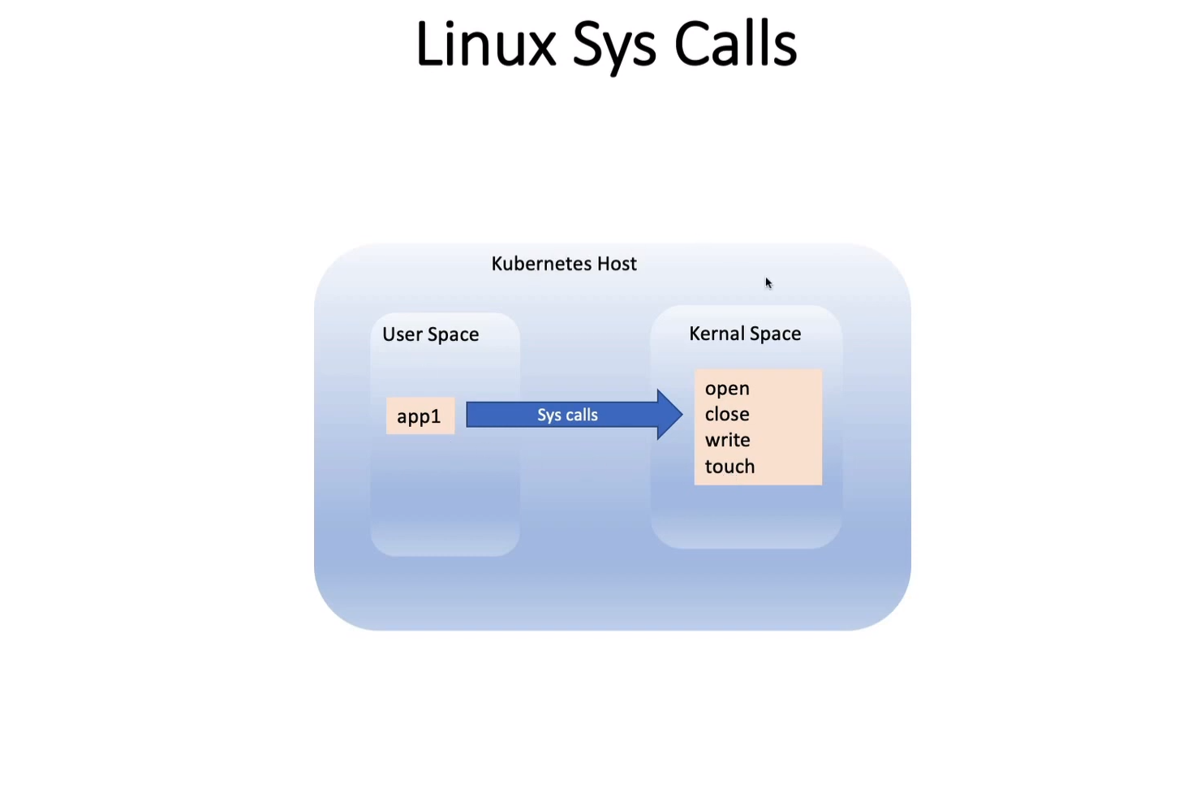

Slide 3
Used for..
Restricting a container’s access to resources
Linux capabilities
Network access
File permission etc..
Main objective: Restricting containers what they’re allowed to do

Slide 4
Working modes
Enforce mode: Prevent the program access
Complain mode: Discover the program access violations and keeps in the system log

Slide 5
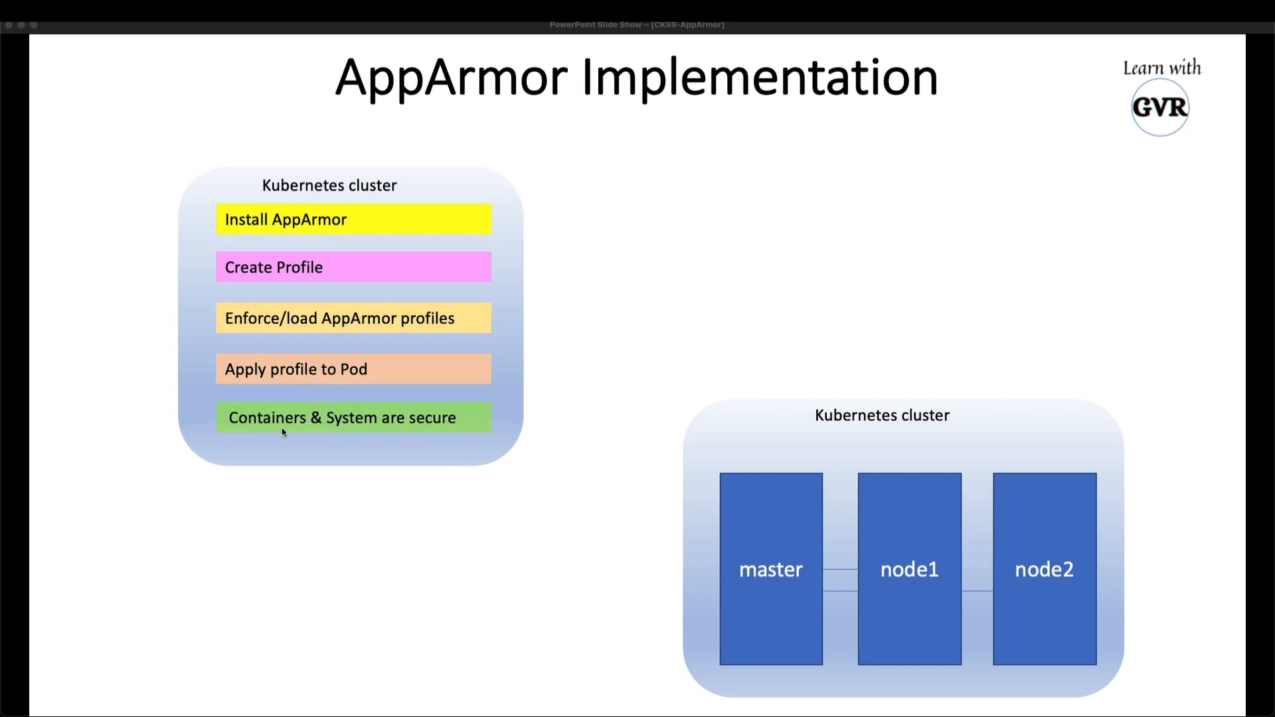

Slide 6
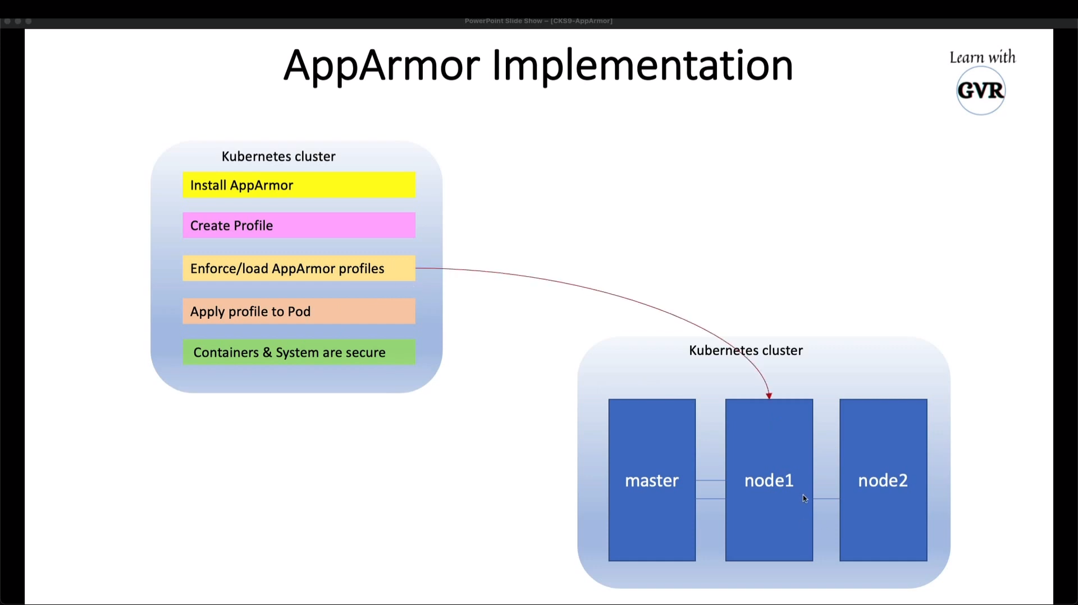

Slide 7


Slide 8
Sample profile
#include <tunables/global>
profile k8s-apparmor-example-deny-write flags=(attach_disconnected) {
#include <abstractions/base>
file,
# Deny all file writes.
deny /** w,
}

Slide 9
Apply to pod
Adding annotations:
container.apparmor.security.beta.kubernetes.io/<container_name>: <profile_ref>

